Slide 1
Module Name: Professional Practice
Raport
Vasile Necsoi

Slide 2
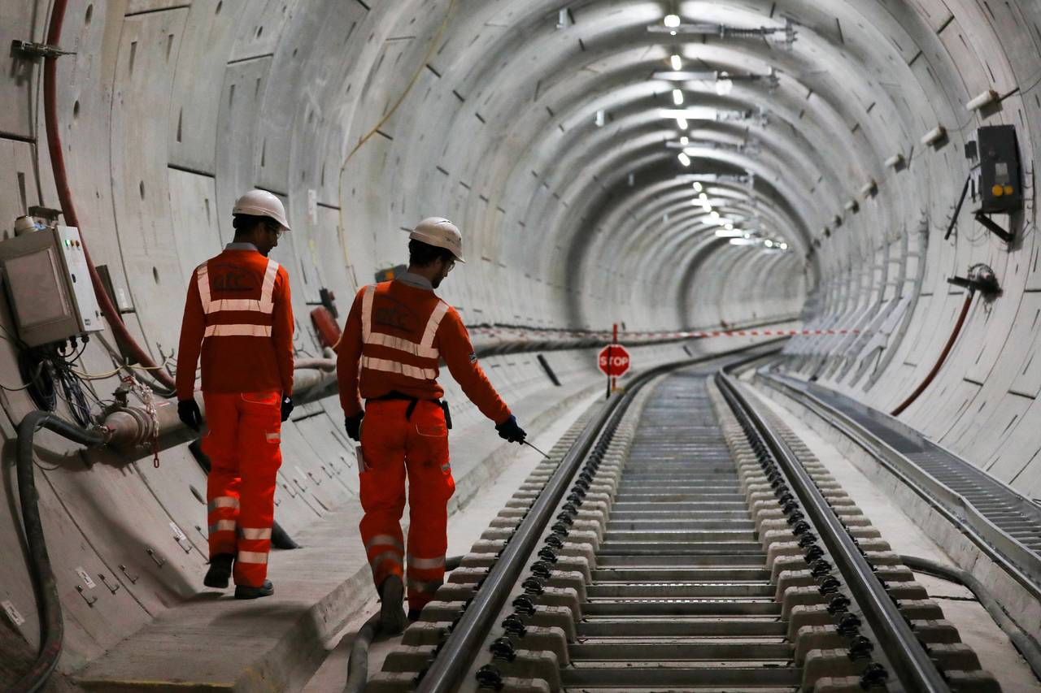
Introduction
BIM (Building Information Modelling): Simplifies project planning, and management of tasks (Gerhards and Greenwood, 2021).
IoT (Internet of Things): Real-time data and information collected by site sensors and connected devices help in improving efficiency (Xue et al. 2020).
Effective collaboration was aided by the visual representation of the application of technical and architectural design solutions as well as the extent of data exchange for builders.
Notes:
The building's design also took energy efficiency into account; the lighting controls and the HVAC/HV systems were made to utilise less energy and save money on energy bills. To reduce energy use and its negative effects on the environment, strategies including the use of geothermal and solar power were implemented. The kind and selection of materials required for building procedures, as well as decisions on construction techniques across the various project delivery stages, were impacted by an LCA.

Slide 3
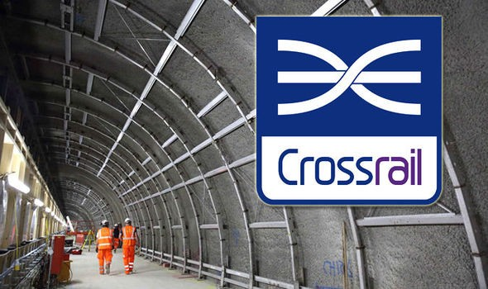
Sustainability and Green Construction
Energy-efficient Designs: Incorporate eco-friendly and energy-saving materials. (Iskandarova and Genus, 2019).
Green Certifications: It is advisable to aim at certification programs like LEED and BREEAM.
Drones and UAVs: Contribute to the capture of site surveys, progress scans and detailed inspections, which will decrease the use of manpower and increase efficiency.
Notes:
Sustainable design criteria were attained throughout the project's inception by adhering to environmental building standards, such as BREEAM. Environmental performance metrics tracked carbon emissions, water usage, and trash generation to evaluate progress achieved towards sustainable goals. In ecologically sensitive building projects, investor interaction with local communities and other stakeholders raised awareness and made sure that everyone adhered with sustainable standards.

Slide 4
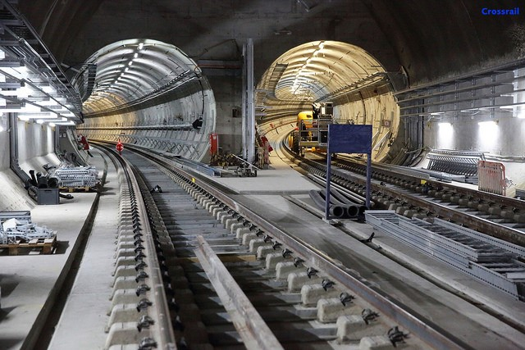
Tunnel Boring Machines (TBMs): The construction of Crossrail has incorporated the techniques
Using modern technologically advanced Tunnel Boring Machines (TBMs) to excavate the tunnels (Key, 2022).
Crossrail stations used passive design strategies including natural ventilation and solar harvesting to reduce energy use.
Innovative Construction Techniques
Notes:
Building information modelling (BIM), which allowed for the digital representation of the infrastructure's functional and physical elements, was a major asset to the London Crossrail Project. Effective collaboration was aided by the visual representation of the application of technical and architectural design solutions as well as the extent of data exchange for builders. Due to the manner it emphasised conflicts between the components before the building phase had started, it minimised misconceptions brought on by many groups working on the same project. In sleek line stations and track systems, part of the work was built off-site so construction time was less on-site and the quality was better. Advanced Surveying and Mapping: Sophisticated equipment such as high-precision laser scanning and Geographical Information Systems were used to map the substructures and check the positions of the paths.

Slide 5
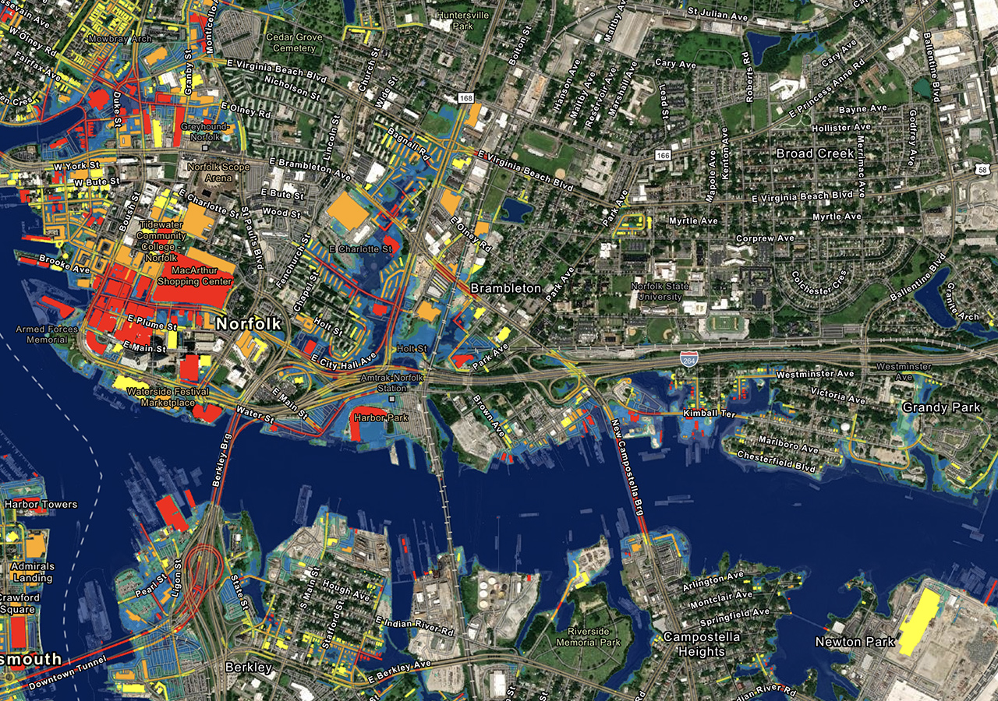
Digital Engineering and BIM (Building Information Modeling)
BIM Coordination: Crossrail made use of BIM during all the phases of construction
Inviting architects, engineers, and contractors to work together (Silva, Imtiaz and Chisholm, 2021).
Virtual Design and Construction (VDC): Visualisation in the fourth dimension drawings involved the use of models (Mach, 2022).
Notes:
The London Crossrail Project utilises modern tunnel boring machines (TBMs) to securely and efficiently bore tunnels under the congested urban terrain of London. These devices expedited the building process, decreased the need for physical labour, and minimised disturbance in the surrounding metropolis. The project demonstrated how to use technology that works in a variety of scenarios by specifically designing and building each TBM for each geographic location.

Slide 6
Sustainable Construction Practices
Green Building Materials: The materials accommodated for the construction of infrastructures should be more sustainable
Have minimal effects on the environment (Samardzioska, Grujoska and Jovanoska, 2019).
Energy Efficiency: Stations and trains include energy-optimal solutions and renewable energy sources shall be used for the equipping of stations and their trains.
Notes:
By detecting prospective hazards and resolving probable operational issues, advanced risk analysis improves risk management. Throughout the process, details like paint optimisation and more efficient project management were achieved with the use of analytics. Asset performance was maximised via improved demand forecasting and maintenance schedule accuracy through the integration of machine learning methods.

Slide 7
Advanced Project Management Techniques
Lean Construction Principles: Thus, frameworks such as just-in-time delivery and lean construction ensured a reduction in overall organizing time.
Integrated Project Delivery (IPD): The increase in contracts for large projects led to faster decisions and the use of integrated teams (Steffen et al. 2020).
Risk Management: Planning mechanisms concerning several risks that may arise during the project implementation, including exemptions like geological conditions and delays.
Notes:
When making decisions about route planning, risk assessment, and environmental effects, GIS applications employ data from several sources. By early discovery of obstacles, thorough mapping avoided building in certain regions and cost losses. Real-time geographic data assisted in monitoring the status of building projects and prevented them from being built in a fixed way with limited room for modification.

Slide 8
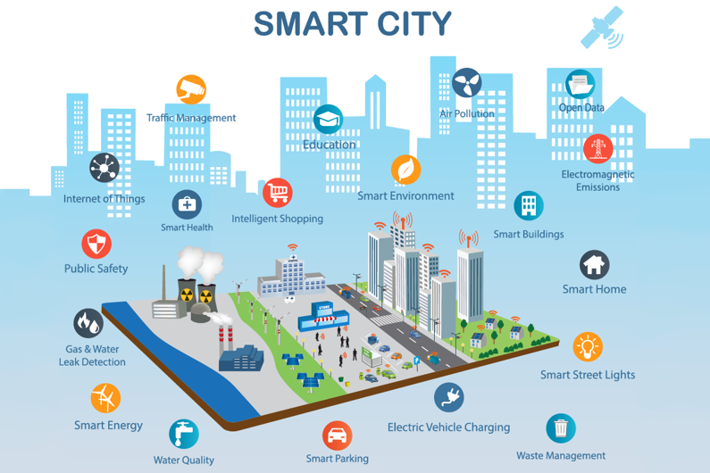
Technological Integration in Transport Systems
Automatic Train Control (ATC): Improved signalling and further automation improved train organisation and safety (Hamzeh et al. 2019).
The integration of real-time information technologies with customer information systems aims to improve customer satisfaction and service organisation (Tvardovsky, Chuchmai and Kalinina, 2021).
Intermodal Connectivity: Links to various transport networks that provide seamless transitions between different modes of travel inside London.
Notes:
Among its advantages are the increased responsibility and transparency offered by the consultants, contractors, and stakeholders in the partnerships. While cloud computing was essential for ensuring data availability and security as well as for enabling both on-site and remote work, it was not as important as project management software.

Slide 9
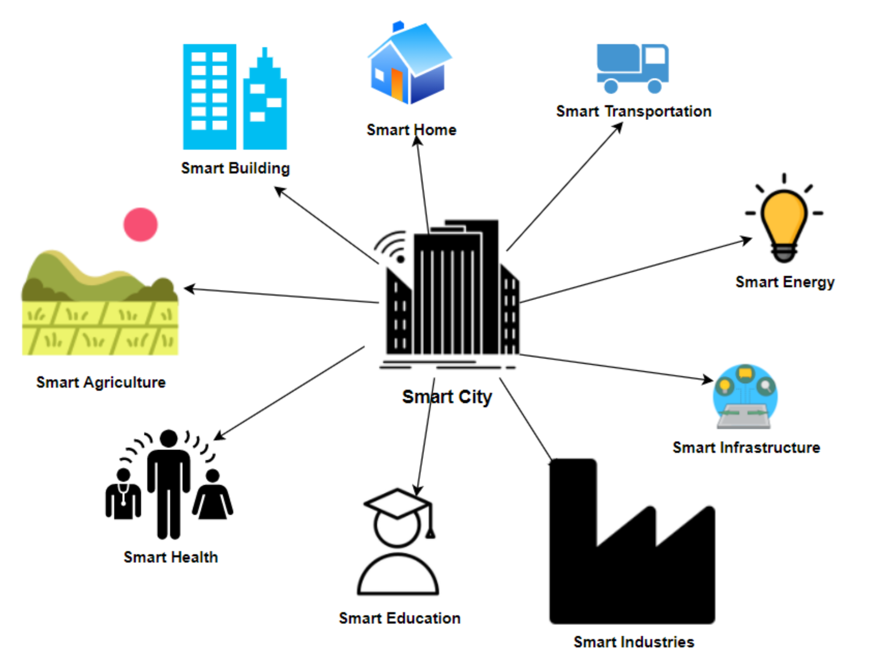
IoT and Smart Infrastructure
Crossrail stations have additional non-energy related equipment built to maximise building comfort and energy utilisation.
The prevention of accidents and the enhancement of project and employee safety standards were made possible by the capacity of IoT-integrated safety systems to identify risks and send out timely alerts (Hamzeh et al. 2019).
Notes:
The Internet of Things (IoT)-connected sensors monitor a variety of construction-related parameters, including temperature, humidity, and structural strain.
Real-time data management and analysis aided in forecasting and decision-making to cut downtime and distribute resources across the project as efficiently as possible

Slide 10
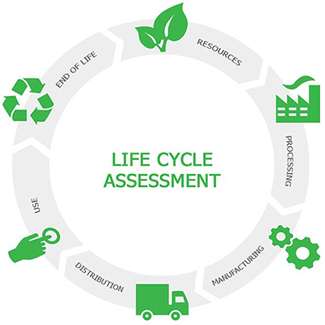
Regulatory Compliance and Safety Standards
Health and Safety Procedures: Everyone entering or using the built building must abide by strict safety regulations (Van, Malyavina and Malikova, 2021).
Regulatory Compliance: Adhering to national and international building, environmental protection, and transportation safety requirements (Ade and Rehm, 2020).
Quality assurance is the process of continuously monitoring and evaluating to ensure that the project's anticipated standards and regulatory requirements are met.
Notes:
The construction sector has to embrace technological innovations in order to properly adapt to and meet current expectations. Drones for site inspection and BIM are two new technologies in project management. Automation and robotics have a major positive impact on construction quality and speed as well as cost savings and risk avoidance. Sustainable and contemporary innovations are defined by clever material management and an eco-friendly design and organisation.

Slide 11
Conclusion
Integrating IoT and AI technologies into various building construction processes
Automating the monitoring of a structure's status and managing projects more effectively.
Using cutting-edge materials, including self-healing concrete and carbon-negative alternatives, may revolutionise sustainability and durability in buildings.
Notes:
Creating virtual models of designs to assess, duplicate, and enhance them to increase productivity and minimise errors before the start of actual construction.
Accelerating the transition to energy-neutral buildings by using renewable energy sources and cutting-edge, energy-efficient design solutions.

Slide 12
References
Ade, R. and Rehm, M., (2020). The unwritten history of green building rating tools: A personal view from some of the ‘founding fathers’. Building Research & Information, 48(1), pp.1-17.
Booth, C.A., Rasheed, S., Mahamadu, A.M., Horry, R., Manu, P., Awuah, K.G.B., Aboagye-Nimo, E. and Georgakis, P., (2021). Insights into public perceptions of Earthship buildings as alternative live projection halls and assembly points. Buildings, 11(9), p.377.
Gerhards, J. and Greenwood, D., (2021). One Planet Living and the legitimacy of sustainability governance: From standardised information to regenerative systems. Journal of Cleaner Production, 313, p.127895.
Hamzeh, F., Al Hattab, M., Rizk, L., El Samad, G. and Emdanat, S., (2019). Developing new metrics to evaluate the performance of capacity planning towards sustainable construction. Journal of Cleaner Production, 225, pp.868-882.
Iskandarova, M. and Genus, A., (2019). UK responses to the energy challenge: dominant framings and new imaginaries. Energy Demand Challenges in Europe: Implications for policy, planning and practice, pp.59-69.
Key, M., (2022). Building Regulations, Codes and Standards: A guide for safe, sustainable and healthy development. ICE Publishing.
Khalid, Z. and Abaas, Z.R., (2021, April). Defining the aspects of the local urban sustainability: Eco-cities as a model. In IOP Conference Series: Earth and Environmental Science (Vol. 754, No. 1, p. 012005). IOP Publishing.
Mach, A., (2022). Analysis of the Possibility of Developing" Earthship" Autonomous Buildings. Civil and Environmental Engineering Reports, 32(3), pp.1-18.
Samardzioska, T., Salih, N., Grujoska, V. and Jovanoska, M., (2019, September). Design of Earthship for Climate Conditions in Macedonia. In IOP Conference Series: Earth and Environmental Science (Vol. 329, No. 1, p. 012052). IOP Publishing.
Silva, G., Yam, A., Imtiaz, R. and Chisholm, C., (2021). Constructing high-quality rest facilities to maximise performance and ensure patient safety. BMJ Open Quality, 10(3), p.e001403.
Steffen, W., Richardson, K., Rockström, J., Schellnhuber, H.J., Dube, O.P., Dutreuil, S., Lenton, T.M. and Lubchenco, J., (2020). The emergence and evolution of Earth System Science. Nature Reviews Earth & Environment, 1(1), pp.54-63.
Tvardovsky, I., Chuchmai, A. and Kalinina, T., (2021). Design of the bracket’s structures and their bracing for industrial climbers’ service of high-rise buildings with facades of solid glazing. In IOP Conference Series: Materials Science and Engineering (Vol. 1164, No. 1, p. 012081). IOP Publishing.
Van, L.P., Malyavina, E.G. and Malikova, O.Y., (2021). Impact of Glass Window to Heat Load in Office Building in Different Climates. In IOP Conference Series: Materials Science and Engineering (Vol. 1079, No. 4, p. 042084). IOP Publishing.
Xue, J., Shen, G.Q., Yang, R.J., Wu, H., Li, X., Lin, X. and Xue, F., (2020). Mapping the knowledge domain of stakeholder perspective studies in construction projects: A bibliometric approach. International journal of project management, 38(6), pp.313-326.

