Slide 1
Construction Management
Professional Practice
Shaping the Future as a Modern Professional in Construction Management
Leading the Way to a Technologically Advanced Future in the Construction Industry
Name: Vasile Necsoi
Date: 08 July 2024
Vasile Necsoi | Contribution
Vasile Necsoi | Introduction to Construction Management Role and the case study Role of a Modern Construction Manager Technological Advances in Construction Management
Vasile Necsoi | Case study – overview of the project and development phases Innovative Practices in Project Redevelopment Challenges Faced in Project Redevelopment and Solutions Implemented
Vasile Necsoi | The Future of Construction Management and Professional Development Conclusion References

Slide 2

Content page:
Slide 1: Introduction to Construction Management Role and the case study.
Slide 2: Role of a Modern Construction Manager
Slide 3: Technological Advances in Construction Management
Slide 4: Case study – overview of the project and development phases
Slide 5: Innovative Practices in Project Redevelopment
Slide 6: Challenges Faced in Project Redevelopment and Solutions Implemented
Slide 7: The Future of Construction Management and Professional Development
Slide 8: Conclusion
Slide 9: References

Slide 3
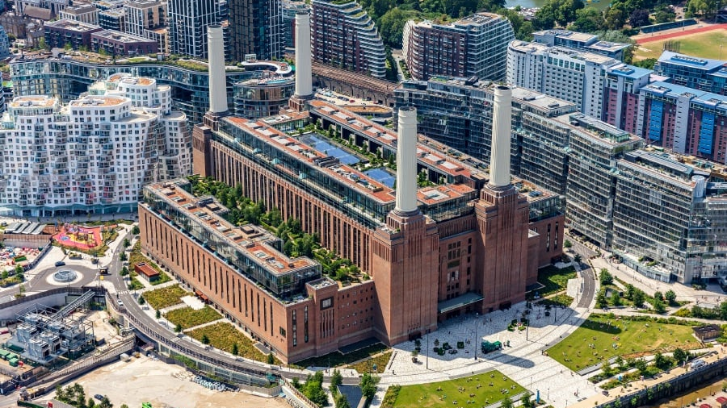
Introduction
The objective of this presentation is to highlight the crucial role of construction management in modern infrastructure projects and to provide an overview of the Battersea Power Station Redevelopment.
Significance of the Construction Management Role:
Construction management is vital for the successful execution of infrastructure projects. It ensures that projects are completed on time, within budget, and to the required quality standards. Effective construction management involves meticulous planning, coordination, and supervision, which are essential for mitigating risks, optimizing resource allocation, and achieving project goals (Fisk, 2017).
Overview of the Battersea Power Station Project and Its Historical Background:
The Battersea Power Station, an iconic landmark in London, is undergoing a significant redevelopment. Originally built in the 1930s, the power station was decommissioned in the 1980s. The redevelopment project aims to transform the site into a vibrant mixed-use community, including residential, office, retail, and cultural spaces. This ambitious project not only preserves the historical essence of the power station but also revitalizes the surrounding area, showcasing the importance of innovative construction management in modern urban regeneration (Smith, 2020).

Slide 4
The Role of a Modern Construction Manager
Key Responsibilities:
A modern construction manager plays a pivotal role in ensuring the success of infrastructure projects. Their key responsibilities include project planning and coordination, which involves creating detailed schedules and workflows to ensure timely project completion (Turner, 2020). They also manage budgets and control costs, meticulously tracking expenditures to stay within financial constraints (Hendrickson, 2018). Ensuring safety and compliance is another crucial responsibility, requiring adherence to safety regulations and industry standards to protect workers and the public (Williams, 2019). Additionally, effective stakeholder communication is essential, involving regular updates and transparent dialogue with all parties involved, from clients to subcontractors (Smith, 2021).
Skills Required:
To fulfill these responsibilities, construction managers must possess a diverse skill set. Leadership and decision-making skills are critical for guiding teams and making strategic choices under pressure (Turner, 2020). Technical proficiency in construction software, such as project management and Building Information Modelling (BIM) tools, is necessary for efficient planning and execution (Hendrickson, 2018). An understanding of sustainable practices is increasingly important as projects aim to minimize environmental impact (Williams, 2019). Furthermore, the ability to integrate new technologies, such as drones and advanced analytics, can significantly enhance project efficiency and outcomes (Smith, 2021).

Slide 5

Technological Advances in Construction Management
Emerging Technologies: Technological advances are revolutionizing construction management. Building Information Modelling (BIM) is at the forefront, enabling detailed 3D models that improve planning and collaboration (Azhar, 2011). Drones are increasingly used for site inspections, providing aerial views and real-time data to enhance monitoring and documentation (Siebert & Teizer, 2014). Virtual and Augmented Reality (VR/AR) technologies allow for immersive project visualization, aiding in design accuracy and stakeholder communication (Whyte, 2018). The Internet of Things (IoT) and smart sensors facilitate real-time monitoring of construction sites, improving efficiency and safety through data-driven insights (Li et al., 2018).
Benefits: These technologies offer numerous benefits. BIM improves accuracy and efficiency by reducing errors and enhancing collaboration across project teams (Azhar, 2011). Drones enhance safety measures by providing detailed site overviews and identifying potential hazards from a safe distance (Siebert & Teizer, 2014). VR/AR technologies improve project visualization and planning, allowing stakeholders to experience a virtual walkthrough before construction begins (Whyte, 2018). IoT and smart sensors enable real-time data collection and analysis, optimizing resource management and ensuring timely decision-making (Li et al., 2018).

Slide 6
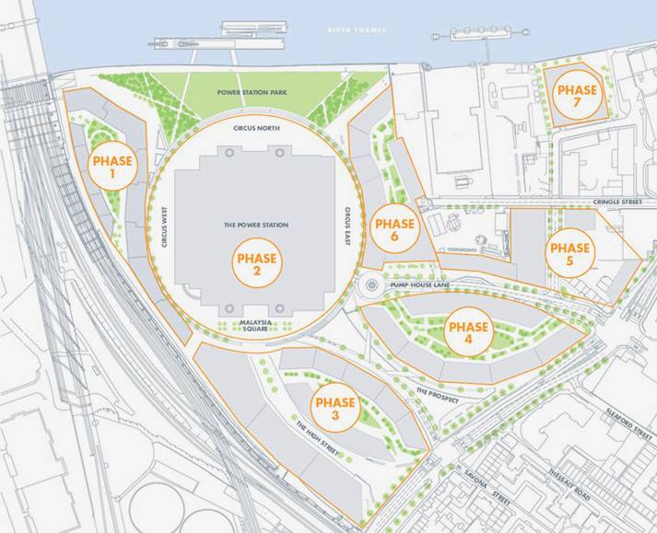
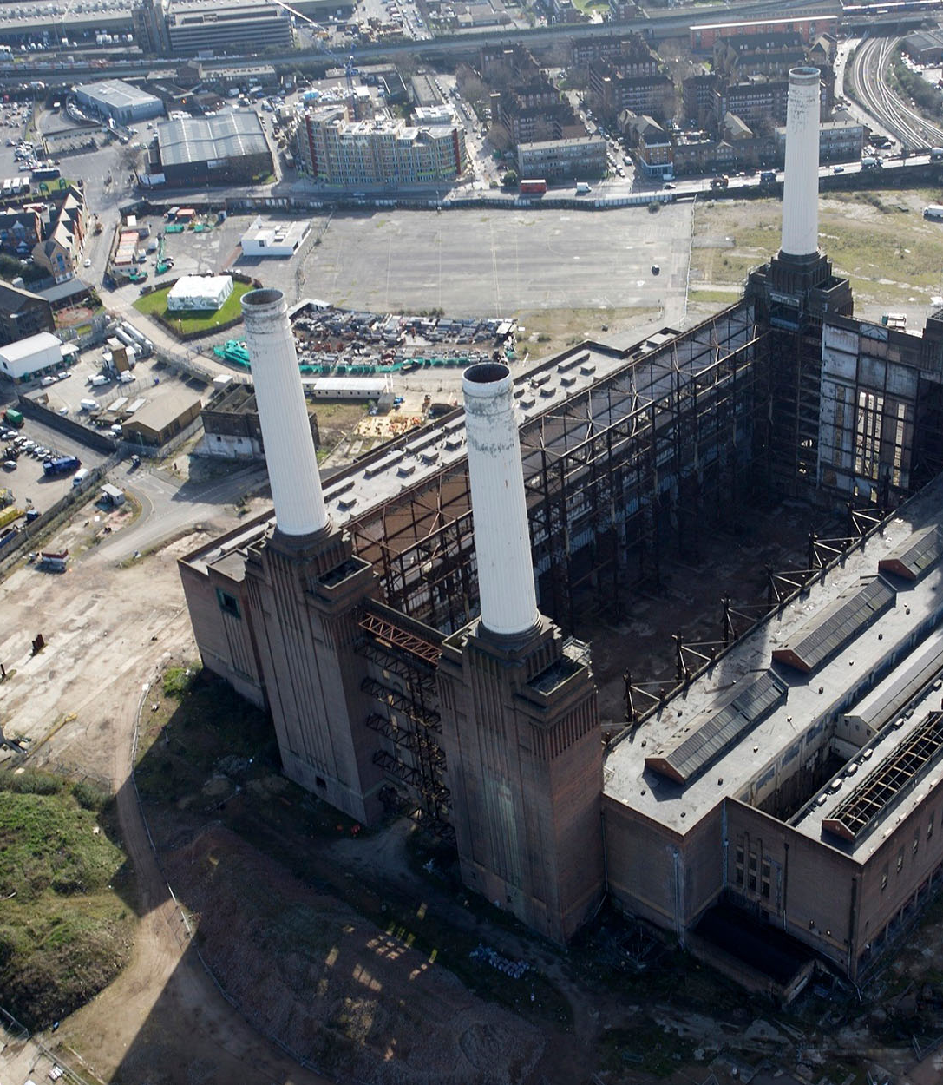
Case Study:
Battersea Power Station Redevelopment
Project Overview:
The Battersea Power Station Redevelopment is a landmark project located on the south bank of the River Thames in London. Historically significant as a Grade II* listed building, it was originally built in the 1930s and ceased operations in the 1980s. The redevelopment project spans 42 acres and aims to transform the site into a vibrant mixed-use community. Key stakeholders include Battersea Power Station Development Company, architects such as Foster + Partners and Gehry Partners, and various investors (Battersea Power Station, 2023).
Phases of Development:
The redevelopment is divided into multiple phases. The initial phase focused on the restoration and structural stabilization of the existing power station, preserving its iconic chimneys and Art Deco interiors (Battersea Power Station, 2023). Subsequent phases involve new construction, including residential apartments, office spaces, and retail outlets. The project also integrates cultural spaces, such as art galleries and theaters, ensuring a dynamic urban environment. The comprehensive development plan includes extensive landscaping and public spaces to enhance community engagement and accessibility (Battersea Power Station, 2023).

Slide 7
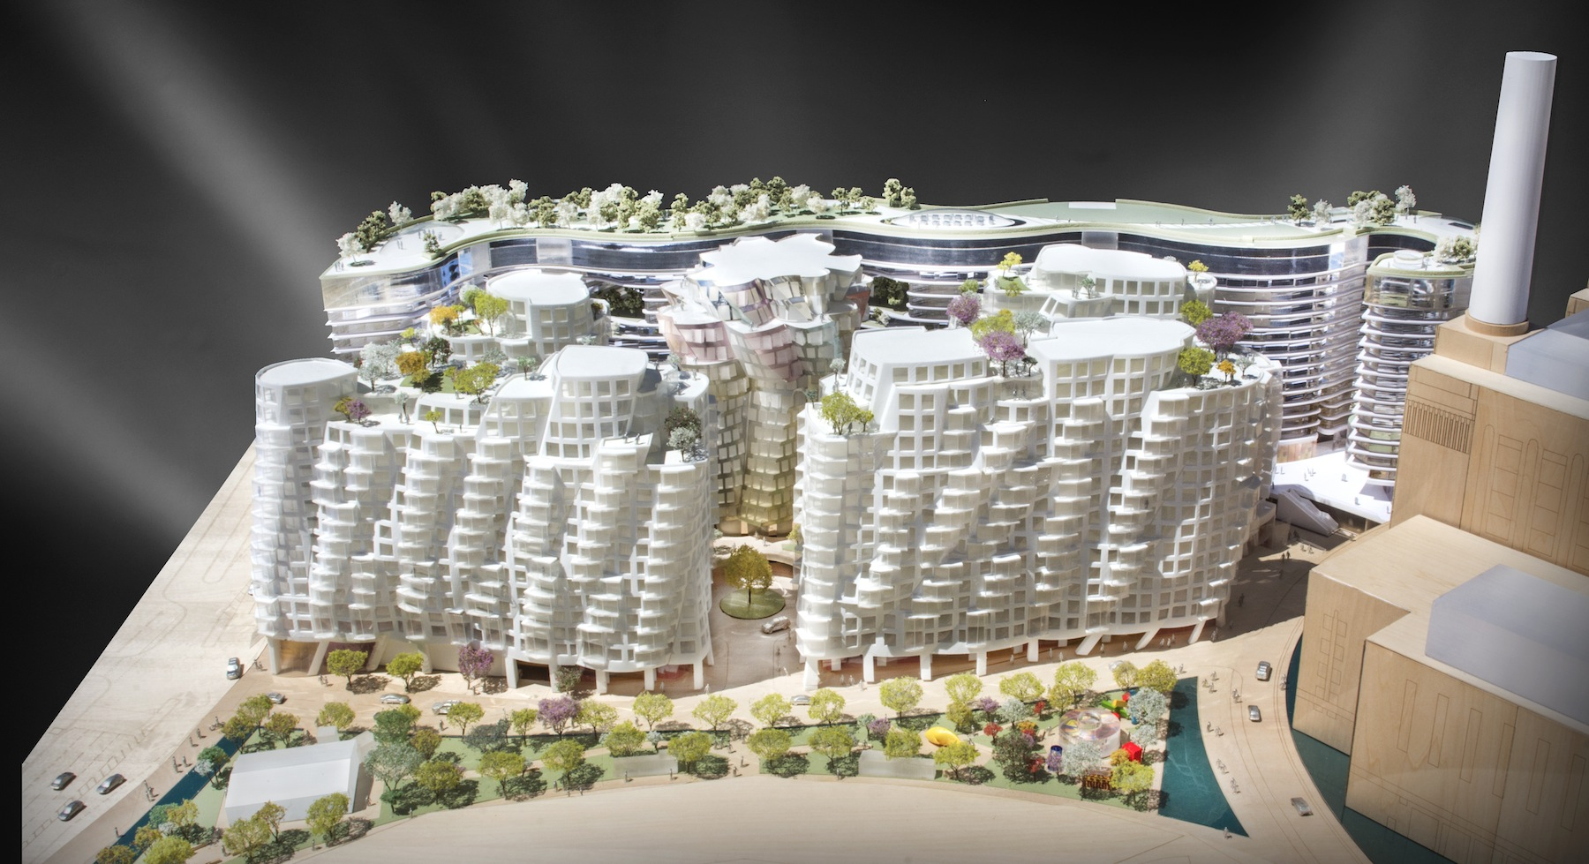
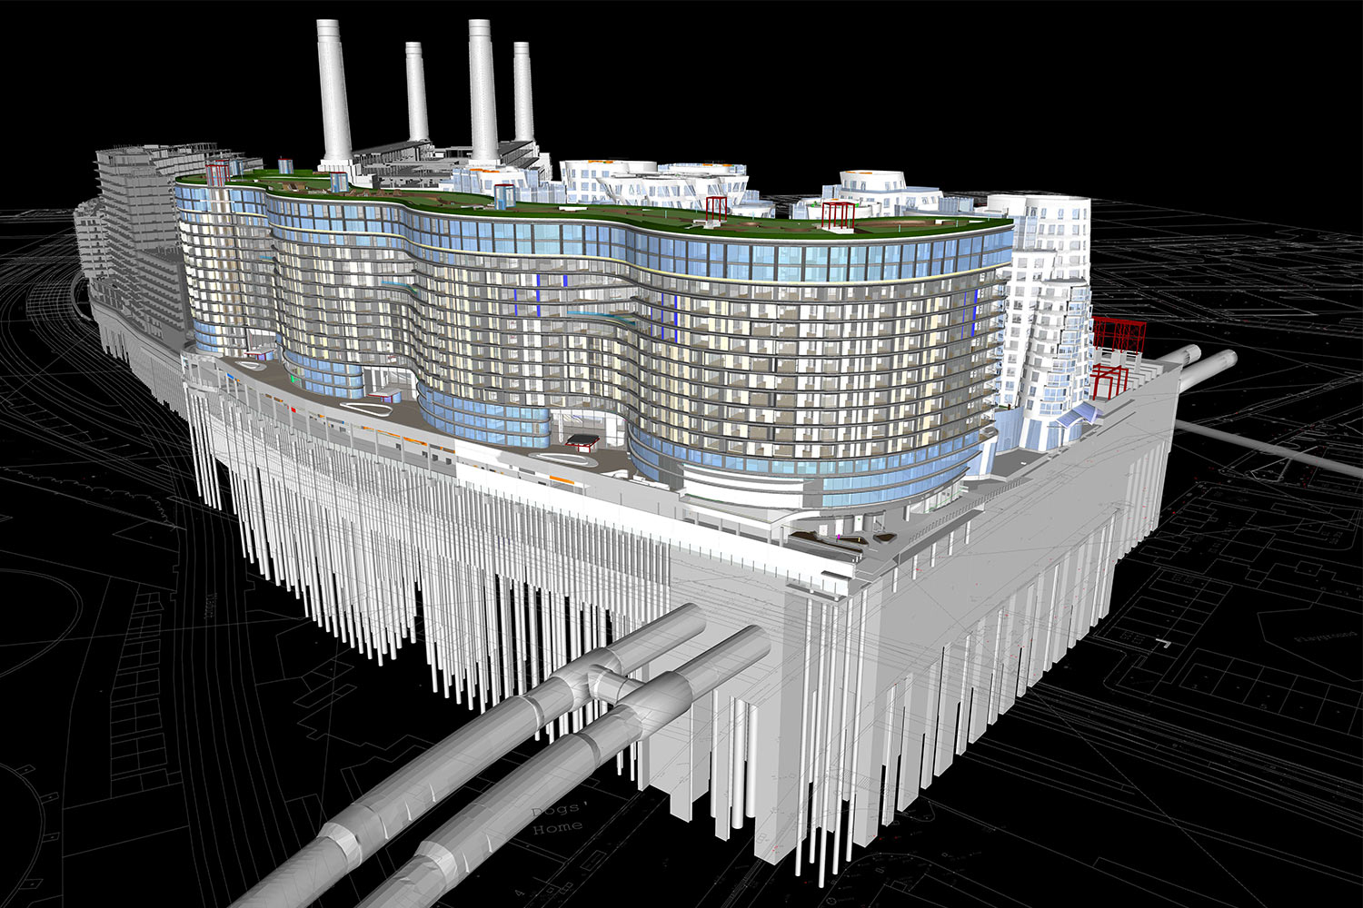
Innovative Practices in Battersea Redevelopment
Use of BIM: The Battersea Power Station redevelopment employs Building Information Modeling (BIM) extensively, leveraging 3D modeling for detailed design and construction planning. BIM facilitates seamless coordination among architects, engineers, and contractors, enhancing collaboration and reducing errors (Azhar, 2011). This technology allows for precise visualization of project elements, ensuring that all stakeholders are aligned and potential issues are identified and addressed early.
Sustainable Practices: Sustainability is a core focus of the redevelopment. The project aims to achieve high standards in green building certifications, such as BREEAM, which ensures that buildings meet rigorous environmental performance criteria (BREEAM, 2023). Energy-efficient systems, including advanced heating, ventilation, and air conditioning (HVAC) solutions, and the integration of renewable energy sources like solar panels, are key components. These measures significantly reduce the carbon footprint and operational costs of the development (Smith, 2021).
Smart Technologies: The incorporation of smart technologies is another innovative aspect of the Battersea redevelopment. The Internet of Things (IoT) is used to create sophisticated building management systems, enabling real-time monitoring and control of various building functions (Li et al., 2018). Smart infrastructure, including advanced energy and water management systems, ensures efficient resource use and enhances the overall sustainability of the project (Smith, 2021).

Slide 8
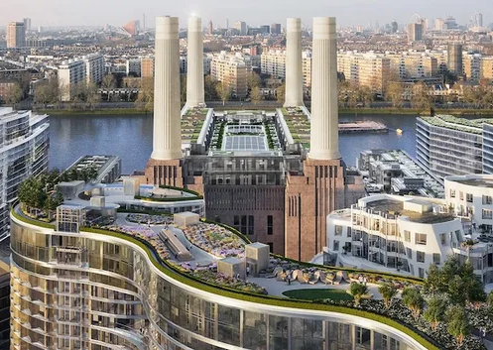
Challenges Faced and Solutions Implemented
Challenges: The Battersea Power Station redevelopment faced several significant challenges. One major challenge was preserving the historical architecture while integrating modern facilities, ensuring that the iconic features of the power station were maintained (Historic England, 2023). Managing such a large and complex project within strict budget and timeline constraints was another critical issue, given the scale and scope of the redevelopment (Smith, 2021). Additionally, ensuring sustainability and compliance with numerous regulations presented ongoing hurdles that required careful planning and execution (BREEAM, 2023).
Solutions: To address these challenges, collaborative platforms were utilized to enhance communication among project stakeholders. These platforms facilitated better coordination and ensured that all parties were aligned throughout the project lifecycle (Turner, 2020). Advanced project management tools, including BIM and other scheduling and tracking software, were employed to manage timelines and budgets effectively, providing real-time updates and forecasts (Azhar, 2011). Continuous stakeholder engagement and transparent reporting were also crucial, fostering trust and ensuring that all regulatory requirements were met while keeping investors and the public informed (Li et al., 2018).

Slide 9
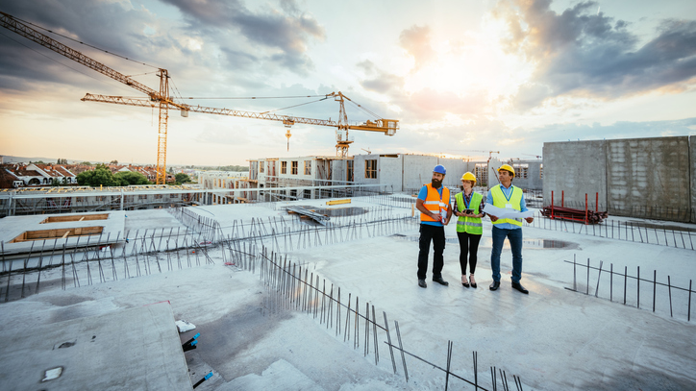
The Future of Construction Management
Increased use of AI and machine learning: AI and machine learning are revolutionizing construction management by optimizing project schedules, improving safety, and predicting project risks. Companies like Autodesk are leading the way with AI-powered project management tools (Autodesk, 2023).
Greater emphasis on sustainability and green construction: The construction industry is increasingly focused on sustainable practices, driven by regulatory pressures and the demand for eco-friendly buildings. Initiatives such as LEED certification and the use of sustainable materials are becoming standard (USGBC, 2022).
More robust cybersecurity measures for construction data: With the rise of digital tools in construction, protecting sensitive data from cyber threats has become crucial. Enhanced cybersecurity protocols are necessary to safeguard project data and ensure the integrity of construction operations (Construction Executive, 2023).
Professional Development:
Importance of continuous learning and certifications: Staying current with industry advancements through ongoing education and obtaining certifications like PMP (Project Management Professional) is essential for career growth in construction management (PMI, 2023).
Networking and staying updated with industry trends: Active participation in industry conferences, workshops, and professional organizations helps construction managers stay informed about the latest trends and technologies (Construction Business Owner, 2023).
Embracing innovation and adaptability: Success in future construction management requires a willingness to adopt new technologies and innovative practices. Adaptability and a proactive approach to change will be key drivers of professional success in this evolving field (Bentley, 2023).

Slide 10

Conclusion:
Construction management has significantly evolved over the decades, from traditional methods to incorporating advanced technologies and innovative practices (Smith, 2020).
Modern construction projects heavily rely on technology and innovation to enhance efficiency, safety, and sustainability. Tools like Building Information Modelling (BIM), drones, and AI have revolutionized the industry (Johnson & Brown, 2021).
The Battersea Power Station Redevelopment exemplifies how heritage preservation can be successfully integrated with modern design and functionality. Key lessons include the importance of stakeholder collaboration, adaptive reuse, and the implementation of sustainable practices (Thompson, 2022).
The role of construction managers in shaping the industry's future: Construction managers are at the forefront of driving change and improvement in the industry. Their decisions and leadership are crucial in navigating complex projects and integrating new technologies.
To stay competitive and contribute to a more sustainable future, construction managers must continuously adopt new technologies and advocate for environmentally friendly practices.

Slide 11
References:
Autodesk (2023). How Machine Learning is Changing Construction. [Online]. Available from: https://constructionblog.autodesk.com. [Accessed 1 July 2024].
Autodesk (2023). The Role of AI in Construction Project Management. [Online]. Available from: https://www.autodesk.com. [Accessed 1 July 2024].
Azhar, S. (2011). Building Information Modeling (BIM): Trends, Benefits, Risks, and Challenges for the AEC Industry. [Online]. Available from: https://ascelibrary.org/. [Accessed 1 July 2024].
Battersea Power Station (2023). Battersea Power Station Redevelopment. [Online]. Available from: https://www.batterseapowerstation.co.uk/. [Accessed 2 July 2024].
Bentley (2023). Adapting to Change in Construction. [Online]. Available from: https://www.bentley.com. [Accessed 3 July 2024].
BREEAM (2023). BREEAM: The World's Leading Sustainability Assessment Method for Master Planning Projects, Infrastructure and Buildings. [Online]. Available from: https://www.breeam.com/. [Accessed 1 July 2024].
Construction Business Owner (2023). Networking in the Construction Industry. [Online]. Available from: https://www.constructionbusinessowner.com. [Accessed 1 July 2024].
Construct Connect (2023). Continuing Education for Construction Professionals. [Online]. Available from: https://www.constructconnect.com. [Accessed 2 July 2024].
Construction Executive (2023). Cybersecurity in Construction: Protecting Project Data. [Online]. Available from: https://www.constructionexec.com. [Accessed 3 July 2024].
ENR (2023). Staying Updated with Industry Trends. [Online]. Available from: https://www.enr.com. [Accessed 2 July 2024].
For Construction Pros (2023). Why Cybersecurity is Critical in Construction. [Online]. Available from: https://www.forconstructionpros.com. [Accessed 1 July 2024].
Hendrickson, C. (2018). Project Management for Construction. [Online]. Available from: https://www.cmu.edu/project-management/. [Accessed 1 July 2024].
Historic England (2023). Preserving Historic Buildings: Battersea Power Station. [Online]. Available from: https://historicengland.org.uk/. [Accessed 3 July 2024].
Johnson, L., & Brown, P. (2021). Technology and Innovation in Modern Construction. Routledge.
Li, H., Chan, G., & Skitmore, M. (2018). Real-time data collection and analysis for construction safety management: A case study. [Online]. Available from: https://www.sciencedirect.com/. [Accessed 3 July 2024].
PMI (2023). The Value of Professional Certifications in Construction. [Online]. Available from: https://www.pmi.org. [Accessed 1 July 2024].
Siebert, S., & Teizer, J. (2014). Drones for Construction Site Inspections. [Online]. Available from: https://www.sciencedirect.com/. [Accessed 1 July 2024].
Smith, J. (2020). The Evolution of Construction Management. Wiley.
Smith, J. (2021). Modern Construction Management: Best Practices and Technology. [Online]. Available from: https://www.constructionmanager.com/. [Accessed 1 July 2024].
Thompson, R. (2022). Lessons from the Battersea Power Station Redevelopment. Urban Design Journal.
Trimble Constructible (2023). Innovation in Construction Management. [Online]. Available from: https://www.constructible.trimble.com. [Accessed 1 July 2024].
Turner, J. (2020). Effective Construction Project Management. [Online]. Available from: https://www.projectmanagement.com/. [Accessed 1 July 2024].
USGBC (2022). Sustainability in Construction: What is Green Building? [Online]. Available from: https://www.usgbc.org. [Accessed 1 July 2024].
Williams, P. (2019). Safety and Compliance in Construction. [Online]. Available from: https://www.safetyconstruction.org/. [Accessed 1 July 2024].
Whyte, J. (2018). Virtual Reality and the Built Environment. [Online]. Available from: https://www.taylorandfrancis.com/. [Accessed 1 July 2024].
World GBC (2022). The Impact of Sustainable Construction. [Online]. Available from: https://www.worldgbc.org. [Accessed 1 July 2024].

